Slide 1
Group Development Session 1
Making Sense of School Leadership Programme (MSSL)
Welcome
Please take a few moments to introduce yourselves to someone in your group. We will begin soon.
Notes:
Welcome to the Making Sense of School Leadership development programme. Before we get into the main content of today’s session, I will briefly explain who is behind this programme, how it came about, and what we hope to achieve.

Slide 2
Programme objectives
To provide a stimuli for development and reflection and the opportunities to practice and work on participants’ approach to sense-making. This includes:
Supporting changes in knowledge - this includes declarative knowledge, procedural knowledge, and self-regulatory knowledge.
Supporting changes in behaviour - behaviour, and the outcome of changes in behaviour, can provide experiences that might challenge participants’ previously held way of work.
Notes:
What do we hope to achieve through this programme?
Leading a school is inherently difficult. School leaders are required to make sense of complex problems, often in conditions of uncertainty and flux.
MSSL aims to support school leaders in making sense of the complex problems they face by recognising this complexity, exploring it, and improving decision making.
Unlike many leadership development programmes which take an overly theoretical approach, GHT draws on the participant’s context and the problems they face in their schools.
The programme employs a variety of methods to stimulate individual and collective sense-making, including salient case studies, personal reflection, and field work.

Slide 3
Session Foci
Session 1: Exploring your school’s wicked problems.
Session 2: Defining a wicked problem in your school.
Session 3: Exploring solutions to wicked problems in your school.
Notes:
The full programme is designed to take 18 months. We are at the pilot stage of the programme. For the pilot, we have designed three short versions of the full programme. This allows us to test and receive feedback on a range of resources. We appreciate your involvement in the programme and welcome your honest feedback on your experience.
The pilot programmes explore different aspects of wicked problems in schools. We will look at what we mean by a wicked problem in a short while, but essentially, we mean problems which are complex and difficult to resolve.
Pilot 1 provides the opportunity to explore your school’s wicked problems. Pilot 2 looks more at a specific wicked problem you have identified. Pilot 3 explores solutions to wicked problems.
Each pilot will follow the same process…

Slide 4
The Course
Notes:
There are five stages to each pilot.
You have already completed stage 1. The Explainer videos introduced you to some theoretical concepts which underpin the programme. We believe that it is important that you understand this theory because:
It will help you understand the reasons for our approach.
We will be making explicit reference to some of the ideas.
We hope it builds confidence that the programme has a sound theoretical basis.
We are currently in Group Development Session 1.
Before our next session, there will be a task to carry out in your school. We call this task an ‘Experiment’ because it involves you forming a hypothesis and testing it. You will be supported in doing this by a Facilitator, who will meet with you before you do the Experiment and again after. These meetings (which we call Individual Development Sessions) will help you plan your experiement and reflect on what you found. More about this later…
When we come together again, we will consolidate your learning through the Experiments you have carried out. Lastly, we will ask for your feedback on the programme.

Slide 5
Programme terminology
Explainers: Videos covering key theoretical concepts.
Group Development Session (GDS): Sessions involving all participants on the programme.
Experiment: Tasks which you carry out to test a hypothesis about your school.
Individual Development Session (IDS): One-to-one support in planning for and reflecting on the Experiment.
Notes:
We will use these terms to refer to the different stages and components of the programme.

Slide 6
What do we mean by School Leadership?
For the purpose of this programme, school leadership is defined as the process of influencing teams, individuals and organisations through discharging leaders’ responsibilities, which include:
Establishing a positive school culture and supportive environment;
Organising and teaching the curriculum;
Adopting effective approaches to professional learning and development;
Attending to student behaviour and the relationships within the wider community; and
Managing an efficient and effective organisation.
Notes:
Please take a moment to read the slide.
Leadership is defined in different ways by different people. When we talk about leadership, we mean how leaders influence teams, individuals and organisations. Leaders exercise their influence in various ways and on various aspects of the organisation.

Slide 7
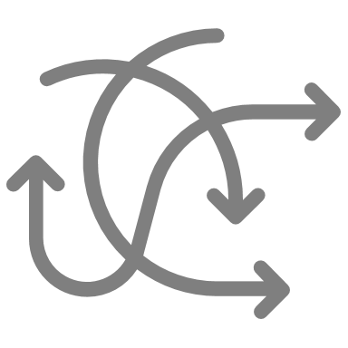
Theoretical constructs
The theoretical model which supports the programme principally incorporates the following:
Complexity theory
Adult development
Notes:
The programme is underpinned by a theoretical model which draws on two theoretical constructs in particular: complexity theory and adult development theory.
These theories were outlined in the Explainer videos. You do not need an in-depth knowledge of these theories to participate in the programme, but understanding the basics may be helpful. Let’s see what you remember about them.

Slide 8
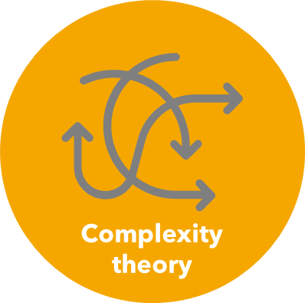
What do you remember about these concepts?
What makes schools complex?
Why are problems in schools difficult to solve?
Why do adults respond differently to complex and uncertain environments?
Notes:
Schools are defined as complex adaptive systems. Complexity is therefore the context for leadership. Leaders are commonly confronted with wicked problems which are difficult (or even impossible) to define and resolve. How leaders cope with this complexity is central to their development as a leader. Mutual collaboration is key to a leader’s approach to dealing with complexity and complex problems.
How leaders make sense of their role, their context, and events, determines how they interact with their environment. Loevinger’s Adult Ego Development (AED) theory describes how the process of sensemaking changes throughout an adult’s life. This includes how adults respond to complex environments. It is asserted that the most advanced (Individualist) stage is associated with practices which would be beneficial for school leaders in coping with complexity. These include comprehending and feeling comfortable with complexity; valuing and seeking new perspectives on a problem; and taking the time to reflect and gain new insights into problems.

Slide 9
Sensemaking and leadership development
How do school leaders make sense of the complex environment within which they operate?
Notes:
These constructs are employed to propose an approach to leadership development which promotes the development of sensemaking by equipping school leaders with ‘sensemaking tools’ which support them to independently and collectively make sense of the needs of their context in order to better deal with the complex and wicked problems of school improvement.
In other words, we propose that leaders develop in part by improving their ability to make sense of complex educational problems. This means coming to terms with complexity and learning to explore and reconcile diverse perspectives on how problems and defined and how they may be solved.

Slide 10
Mental models
We can think of a leader’s expertise as a mental model. These models are how we make sense of what we experience.
The programme is designed to help build better mental models about the problems we face in our schools by supporting the integration of theory, experience, and what we learn about other peoples’ perspectives on a problem.
Notes:
Fundamental to sensemaking are the mental models that give meaning to experience. The programme is designed to maximise the connection between learning about different types of knowledge (declarative, procedural and contextual) alongside exposure to personally salient experiences.
The cyclical nature of the programme allows participants to reflect and act upon the previous session, leading to a developmental process.

Slide 11
Wicked Problems
Some parts of the problem are unique
Other people would provide an alternative description of the problem.
The problem is linked to another problem or solution.
Notes:
Let’s turn our attention to wicked problems.
‘Wicked problems’ is a term used to describe the challenging problems that we often encounter in complex environments.
Wicked problems are hard to describe and isolate. They are often linked to other wicked problems, or ‘nested’ in larger problems. The way the problems manifest may be particular to the context. Different people may describe or think about the problem in different ways. They may not even agree that there is a problem!

Slide 12
Wicked Problems
There is no solution to the problem that is obvious and previous experience doesn’t tell you what to do or what is likely to happen.
You cannot predict what effect your solution will have.
There is no 'right' answer; trying to solve the problem will lead to another problem you have to solve.
Notes:
Wicked problems are never fully solved. You can make progress, but there are many ways you could proceed, none of which are guaranteed to achieve the outcome you seek. Predicting what will happen when you act on a wicked problem is difficult. Sometimes the solution you implement will itself give rise to new problems.
Once you recognize wicked problems you won’t stop seeing them!
But not all problems are wicked. There are also many ‘tame’ problems in schools. A tame problem isn’t necessarily easy to solve, but it will be easier to pin down – more certain – easier to isolate. Tame problems can be ‘fixed’.
In reality, there is not a binary distinction between wicked and tame problems. It is more a continuum. We may say some problems are tamer or more wicked than others. We propose that wicked and tame problems require a different approach, therefore it may be helpful to consider just how wicked a problem is before you act.

Slide 13
Relevance for school leaders
Small actions may have a large impact on the school system or wider systems
Difficult to establish cause and effect
New emergence interacting with systems
Awareness of uncertainty for the long-term
Awareness that other systems impact the school system
Interactions change the system
Harness nested and sub-systems to share resources and aid improvement
Influence and improve policy, practice and research
.
(Stacey, 1996; Wallace, 1996; Harte and Jelinek, 1999; Morrison, 2002; Hawkins and James, 2018)
Notes:
Why should school leaders understand the idea of wicked problems?
They may need to work harder at understanding the problem
They might come to terms with the ‘unfixable’ nature of the problem and be more realistic about likely success
They will expect things to happen that they didn’t expect to happen
They may learn to get better at securing improvement.

Slide 14
A critical reflection
Think about the complexity within your school.
Are there problems which you keep coming back to?
Why are these problems never fully resolved?
To what extent is there agreement on the causes and solutions to the problems?
.

Slide 15
Case Studies
1: A wicked cultural problem
2: A wicked student problem
3: A wicked curriculum problem
4: A wicked teacher development problem
.
Notes:
We are going to look at some examples of wicked problems by considering two case studies.
The case studies have been written to introduce what a wicked problem may look like in practice. They have been written with a particular aspect of school leadership in mind e.g. leading the curriculum or improving school culture. However, the nature of wicked problems mean that they defy being pigeon-holed.
We will have time to read the case study, then to work in groups to explore the wicked problem and our perceptions about what may be going on, and how we may seek to address the problem as a school leader.

Slide 16
Case Study 1
Questions
Explore the different perspectives offered by Maria, Michael and Prisha. These questions may help structure your thinking:
Maria has described a problem which is frustrating her. Michael has offered a reason which may explain Maria’s problem. What impression might you form of the problem if you had only spoken to Maria and Michael?
Prisha offers a different perspective to Michael. Is one right and the other wrong?
To what extent are Maria, Michael and Prisha describing the same problem? Why do they see things in different ways?
Begin to formulate a definition of the problem. These questions may help structure your thinking:
How would you define the problem the school must address if it is to improve?
How might your background, position, and experience affect how you see the problem?
To what extent is the problem you describe ‘wicked’?
.

Slide 17
Case Study 2
Questions
Consider how Jasmine might come to better understand the problem. These questions may help structure your thinking:
What assumptions appear to underpin Jasmine’s attempts to solve the problems of lateness and disorderly transition between lessons?
Who might Jasmine speak with to challenge her assumptions?
Are the problems of lateness and disorderly transition separate problems, connected problems, or manifestations of the same problem?
Consider why Jasmine’s task is so difficult. These questions may help structure your thinking:
Why does each attempt to solve the problem cause new problems elsewhere?
Are the problems Jasmine describes linked to other common problems faced by schools?
Is Jasmine likely to identify a single underlying cause which can be fixed?
.

Slide 18
Reflection
What have you learnt about the how wicked problems manifest in your school?

Slide 19
Experiments
A: Exploring your school’s wicked problems with others
B: Defining a wicked problem in your school
C: Exploring solutions to wicked problems
.
Notes:
Hopefully you are now better equipped to recognise wicked problems in your schools.
Following today’s session, we would like you to explore how wicked problems manifest in your own context. To do this, we have designed some Experiments. We ask that you do one of these.
The task is called an Experiment because we will ask you to form a hypothesis about your school and then to test this hypothesis by exploring the views of your colleagues. By doing so, we hope that you will come to think differently about the problem/s.
To support you in carrying out the experiment, you will have a one-to-one with an Individual Facilitator. This person will help you formulate the hypothesis and plan the experiment. They will then help you reflect on your findings.
The framework you will use to structure this process is called the Ladder of Inference. We are going to watch a clip of academic Vivianne Robinson explaining what the Ladder of Inference is, and how it supports sensemaking.

Slide 20
The Ladder of Inference
The Ladder of Inference is a model of the steps we use to make sense of situations in order to act. It helps us to think about our thinking and to coordinate our thinking with others.

Slide 21
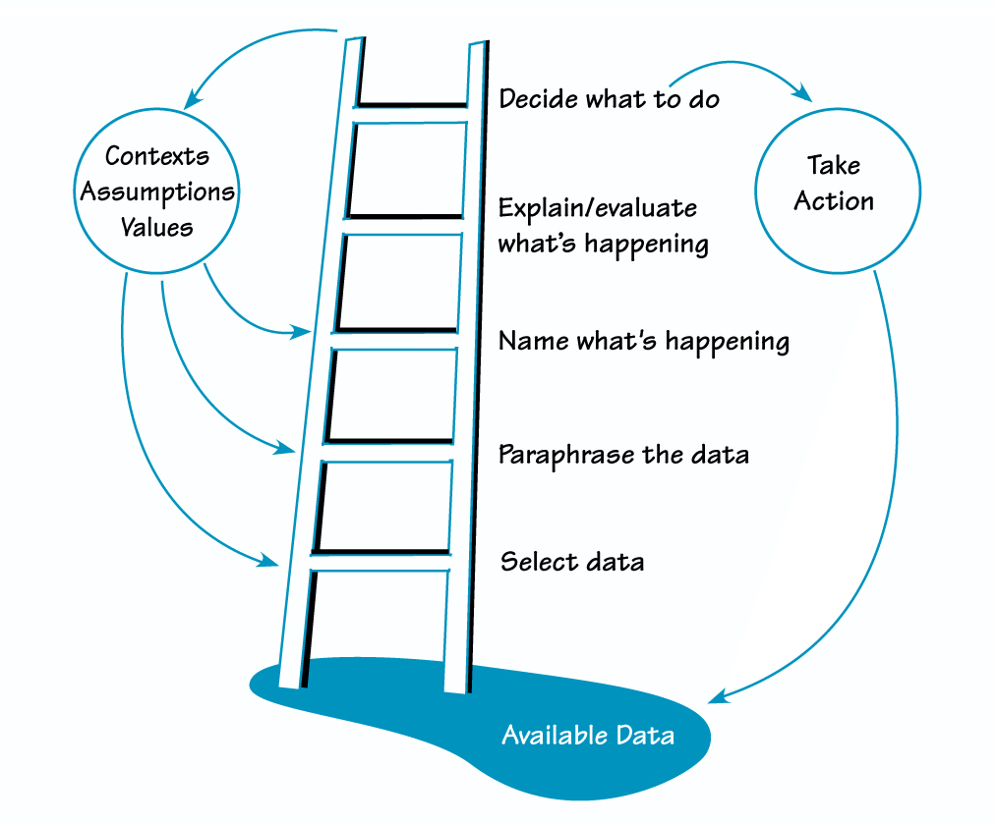
A Sensemaking Tool
Our assumptions, values, and beliefs influence how we select data, interpret what is happening, and decide what to do. Our interpretations and decisions then feedback to reinforce (usually) our assumptions, values, and beliefs. We act on the basis of our interpretations, and our actions affect what data is available to us. So our ways of understanding and acting in the world create a self-reinforcing system, insulating us from alternative ways of understanding.
Notes:
Let’s look at each step of the ladder and how we may use this framework in carrying out and learning from the Experiment…
Now let’s look at the details of the Experiment you will be carrying out.

Slide 22
Experiment A
Identify the main wicked problems in your school.
Explore what colleagues perceive the main wicked problems to be.
Reflect on the similarities and differences between perspectives.

Slide 23
Next steps
.
Organise to meet with your Individual Facilitator.
Carry out the Experiment.
Meet again with your Individual Facilitator to reflect on your findings.
Be prepared to talk about your Experiment at the next Group Development Session.

Slide 24
Thank you!
.
Thank you for your participation and contributions today.
If you have questions, please contact me:
By phone:
By email:

